Slide 1
Training Linear Regression Model

Slide 2
Table of Contents
Introduction
Design
Implementation
Test
Conclusion

Slide 3
Introduction
In this assignment we will use google colab to implement a linear regression model by solving the normal equation. We will use abalone length as our feature and get the height as our prediction from the algebraic equation. When we finish building the model, we will then test it against the linear regression model from sklearn library to see if our model can be used reliably.

Slide 4
Design
We first has to take our already preprocessed data and then transform it into an array form.
Our data for this project is list of features for the Abalone Animal, we are Interested in the Length and Height features, we will try to use the length data for our features and use the height data as our labels, and then train the linear model using this data set

Slide 5
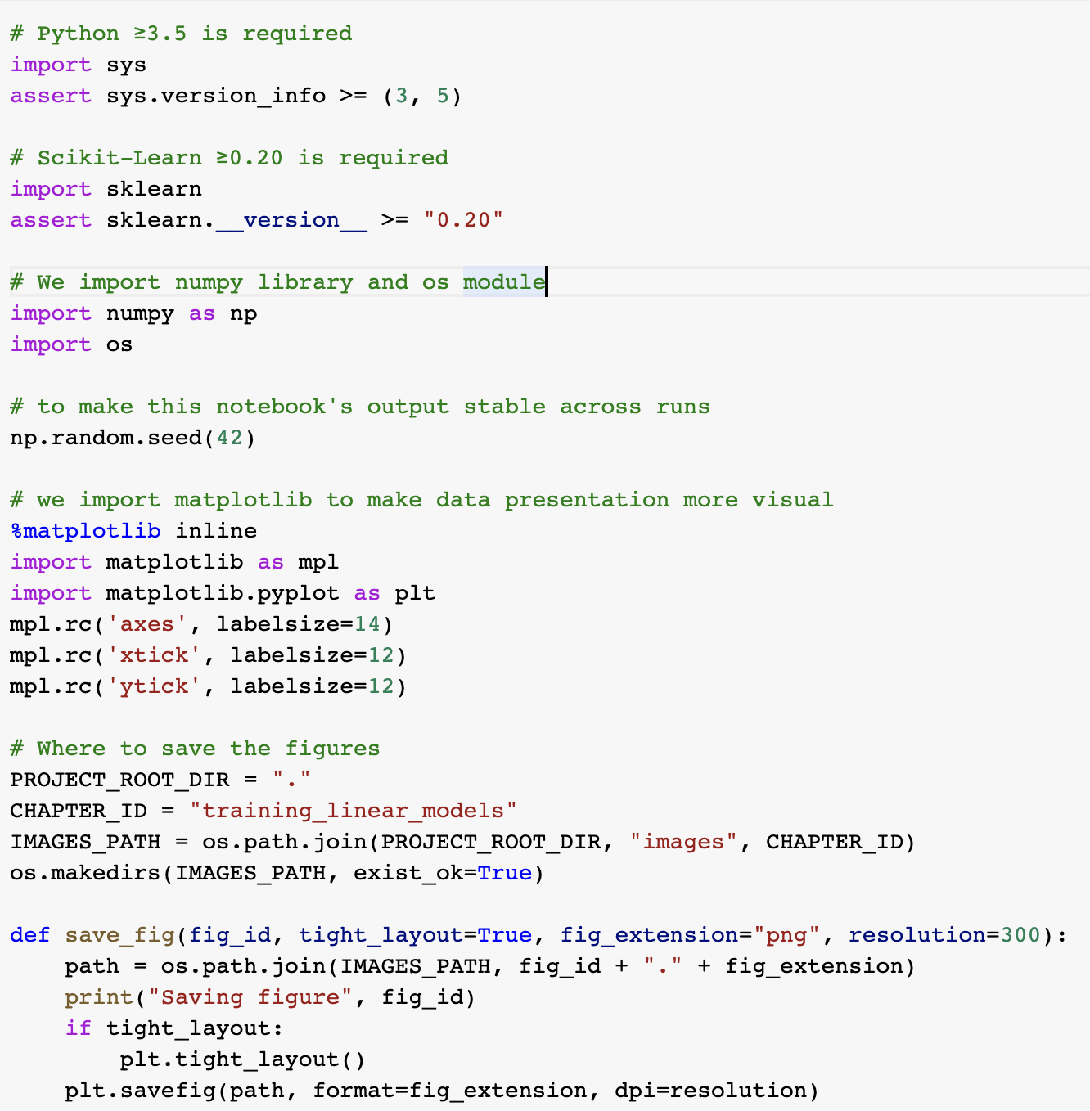
Implementation
Set up our Workspace
We import the needed libraries and modules

Slide 6
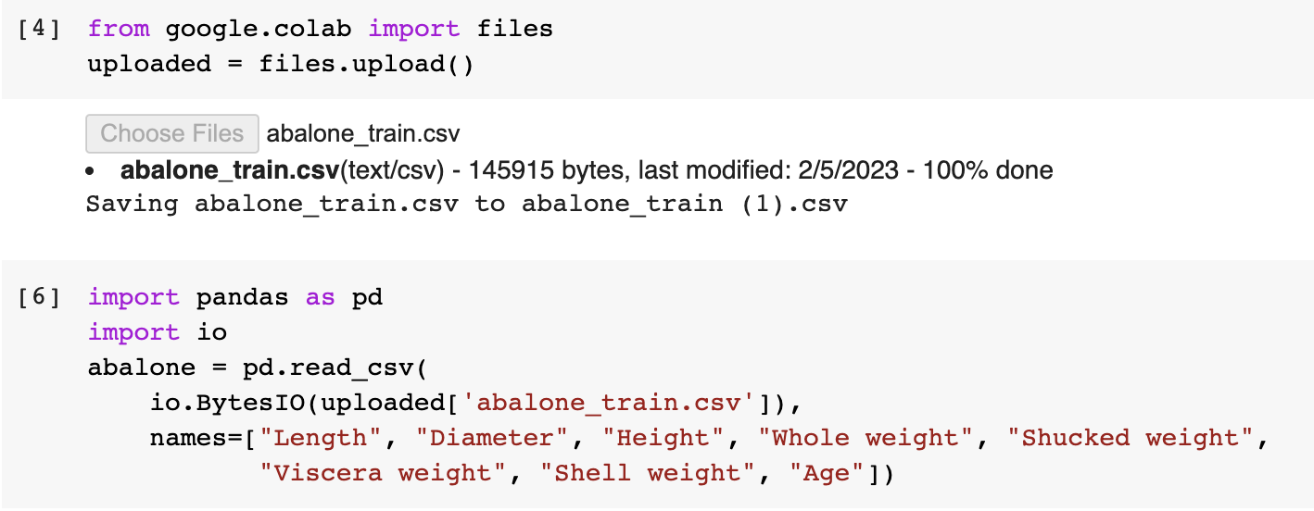
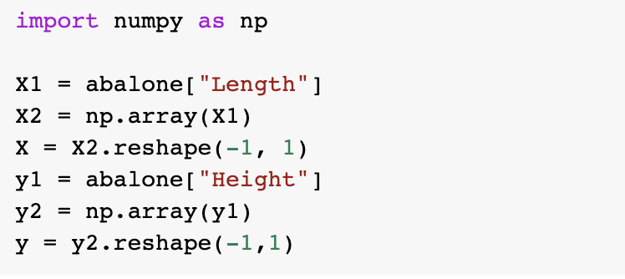
Implementation - Continued
We Import the dataset
We then have to extract and transform the data we need into a workable form such as np.arrays

Slide 7
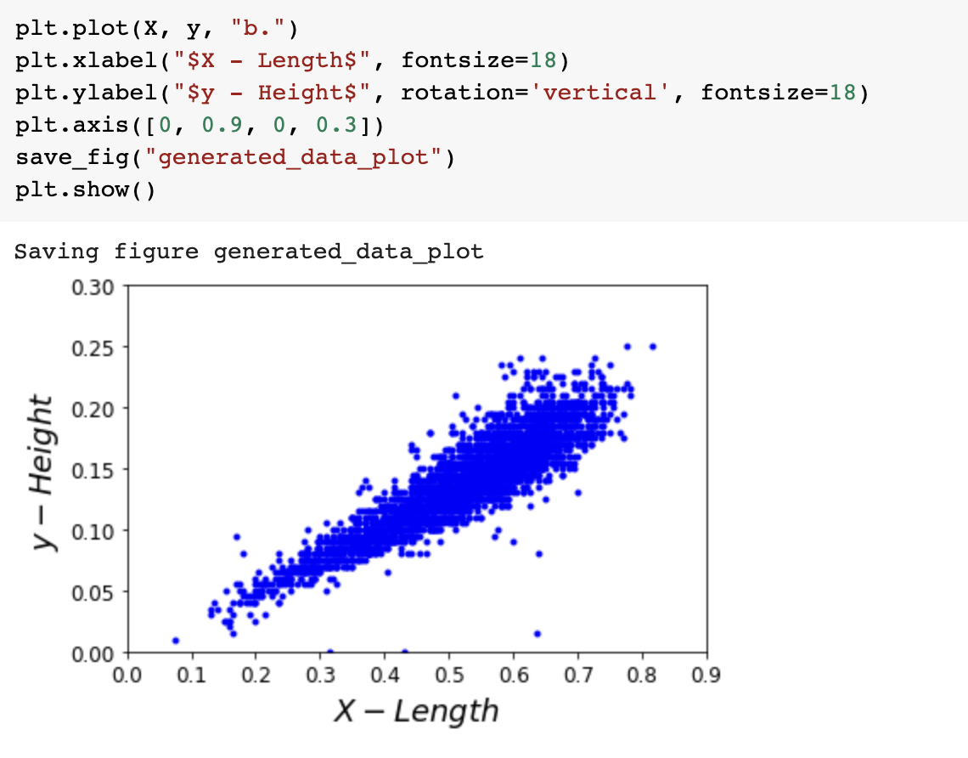
Implementation - Continued
Plotting our Training Data

Slide 8
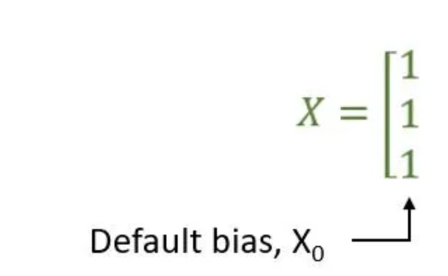
Implementation - Continued
We have to add a bias term to our training data

Slide 9
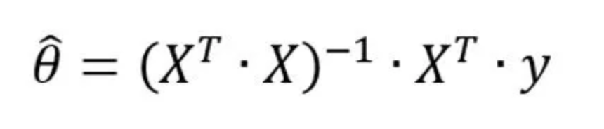
Implementation - Continued
We then calculate the best parameter for our data by using the normal equation
The np.linalg.inv function calculates the inverse of a matrix, and the subsequent dot products calculate the optimal values for the parameters by finding the minimum of the mean squared error between the predicted values and the actual values in the training data.

Slide 10
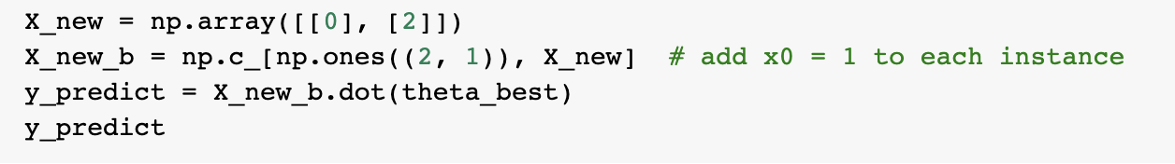
Test
Now we make predictions using our new calculated parameter

Slide 11
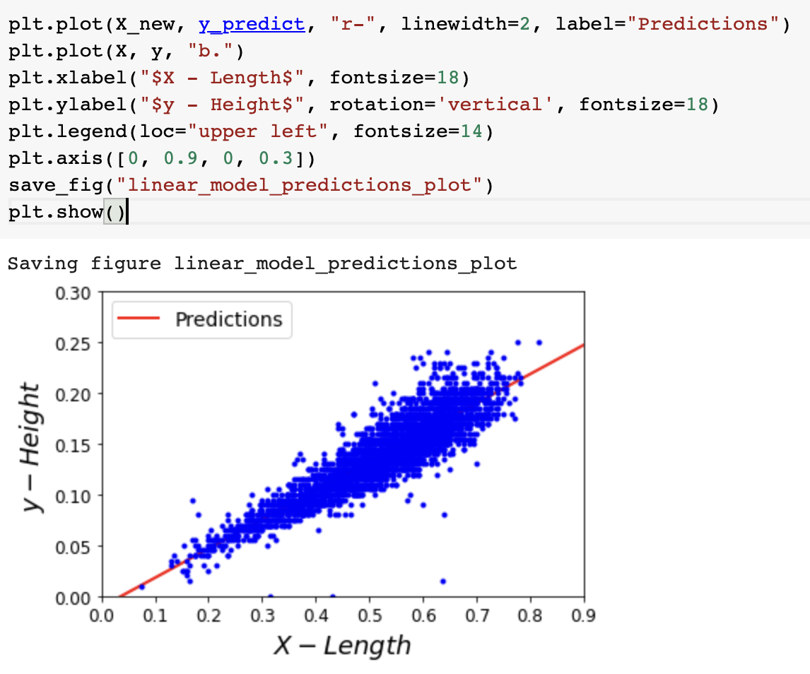
Test
We then creates a scatter plot of the training data (X, y) and a line plot of the predictions y_predict using the calculated model parameters theta_best

Slide 12
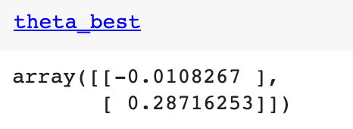
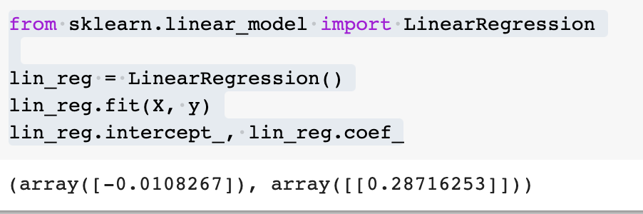
Test against sklearn.linear_model
We will test our model by comparing the parameter theta_best we calculated against the Parameter generated from the data using sklearn.linear_model
From the pictures we can see both models correctly generate parameters that make predictions that correctly fit.

Slide 13
Conlusion
In this assignment, we tried implementing a linear regression model using the abalone data, we first transformed the data into a medium that the numpy library can better work with. After that we used these data to generate parameter theta_best by solving the normal equation.
For this assignment, it was possible to use the normal equation, but for bigger datasets it is not optimal to do so.

